Slide 1
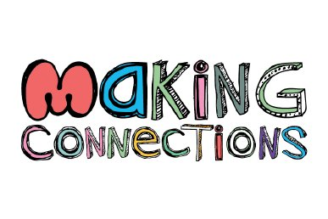


ISLN
November 2012
to Teacher Effectiveness
Notes:
(fiber that holds it together)
Last time we met, we began “laying the groundwork” so that you could go back and support teachers’ and leaders’ in your districts in a foundational understanding of the Teacher professional growth and effectiveness system.
This time we want to continue laying the groundwork by making connections between your work to implement the Common Core and teacher effectiveness.

Slide 2
Slide removed reduce file size

Slide 3

Aesop’s Fable
The Goose That Laid the Golden Eggs
http://www.youtube.com/watch?v=i2xO2Z2DXsc
Notes:
Let’s start our session with a story. You probably remember this story, but today think about how this story relates to our teachers and our students.
Start at :50 Stop at 2:20 (total time 1:30)
Dayea got the story started for us – who knows the rest? The goose lays one golden egg a day; the farmer begins to get greedy and wants more than a golden egg a day; The farmer kills the goose thinking he can collect all the eggs at once only to find no eggs inside the goose; the farmer who wasn’t satisfied was left with nothing.
Okay, so kind of a strange story to relate to our goals as educators - that is unless you think like Stephen Covey

Slide 4
Video Removed to reduce file size

Slide 5
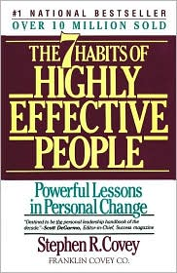

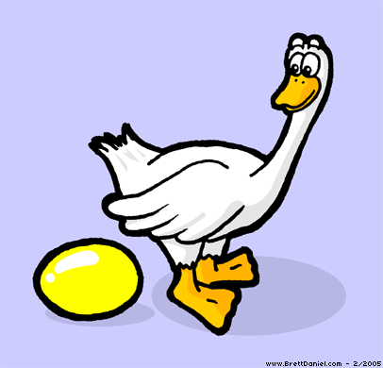
The Goose and the Golden Egg
The Paradigm of Effectiveness
Notes:
Stephen Covey, author of The Seven Habits of Highly Effective People, uses this story to frame what effectiveness really means. He applies it to all walks of life. This paradigm is the basis of all the seven habits.

Slide 6
Slide removed reduce file size

Slide 7

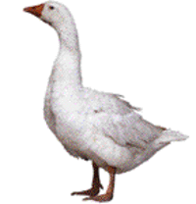
Covey’s Paradigm of Effectiveness
P/PC Balance
Production
Production
Capability
Notes:
Covey calls this idea production and production capability. Production is the results you want, the golden egg; production capability is how you get there, the goose. Covey tries to get us to think differently about the golden eggs – we have to nourish the goose if we want a steady or lifelong supply of golden eggs. We need a P/PC balance.
The farmer found out the hard way that if he neglected the goose, or didn’t care for it properly, no more golden eggs.
Covey’s paradigms are based on natural principles. We can think of a principle as simply as “just the way it is” – no matter if we work against it or with it – it just is, every time. So, the point Covey makes here is that often we place too much focus on the results we want and neglect the resource, or asset, that gets us there. We tilt the P/PC balance. If we don’t focus on both, the production, the golden egg, and our capacity to get the golden egg, the goose, we will eventually loose in one way or another or we will not get the results we truly desire. The principle - there are no short cuts.
This applies to all areas of life – to the business world, our health and personal lives – and to the education of our students.

Slide 8


Covey’s Paradigm of Effectiveness
P/PC Balance
CCR
Graduation
Rates
Passion for Teaching
Capability
Achievement Results
Student Success
Enthusiasm
Commitment
Production
Production
Capability
Teacher
Capacity
Student Success
Notes:
So, how can we apply Covey’s paradigm of effectiveness to our students and teachers?
What’s the golden egg in education? Our students’ success. Whether we see it as increased graduation rates, College and Career Readiness, Achievement results – it is really about students having the ability to be successful in today’s world and their futures.
How do we get them there? We build the capacity of our teachers – we need their enthusiasm, their passion for teaching, we need to support their ability to teach effectively through improved teacher training programs, improved induction of our new teachers, and sustained support for effectiveness. By supporting our teachers, and not neglecting the goose, we gain the commitment that makes teaching strong and positively impacts student success.
The point - We cannot simply focus on results and neglect our teachers in all these capacities. To improve that score, we need to look at effective teaching practice, not only at the student outcomes. Student outcome is the result of instructional practices. We must keep the P/PC balance to get the results we truly desire.

Slide 9

Today’s Targets
I can connect the KDE strategic plan priorities to our schools’ / district’s vision and goals.
I can recognize rigorous implementation of The Common Core through the use of the Literacy Design Collaborative (LDC) and Math Design Collaborative (MDC) instructional tools.
I can apply the Framework for Teaching to identify and support effective teaching practices.
Notes:
Ask: “Do you know of a teacher’s classroom where you can see LDC and MDC / FALS being implemented?”

Slide 10
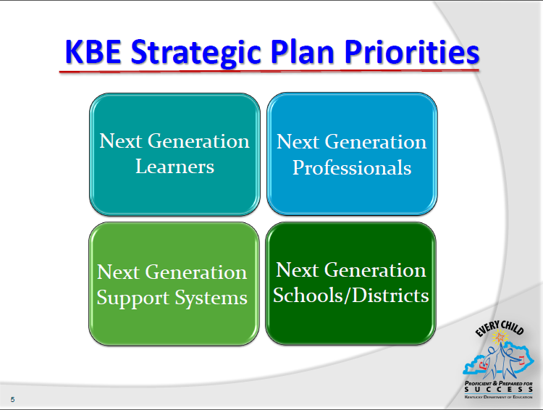
Notes:
In 2010, the commissioner outlined the KBE strategic plan for Kentucky schools.
The Strategic Plan is organized by Strategic Priorities, Objectives and Goals--goals are defined by a unique Delivery Plan, which will include various projects, or strategies.
The Five Strategic Priorities Are:
· Next-Generation Learners
· Next-Generation Professionals
· Next-Generation Schools and Districts
· Next-Generation Support Systems
We will briefly address each of these priorities.

Slide 11
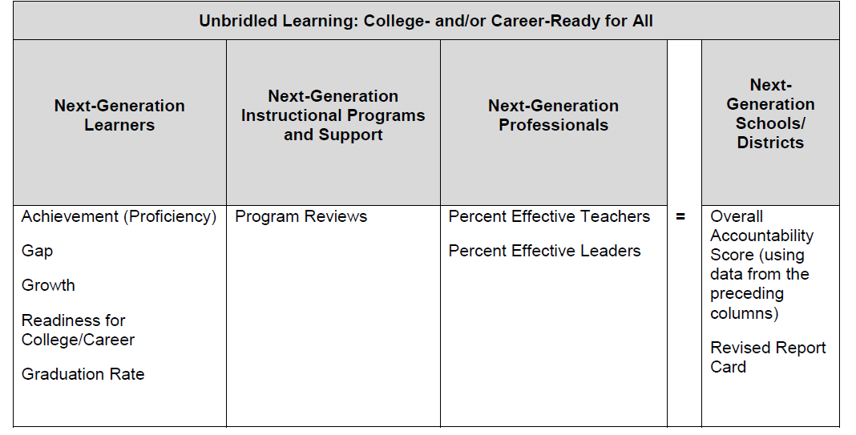
KY Accountability System
Notes:
You may be familiar with this format for the accountability system. Under each area, you see the components that make up that accountability area.

Slide 12
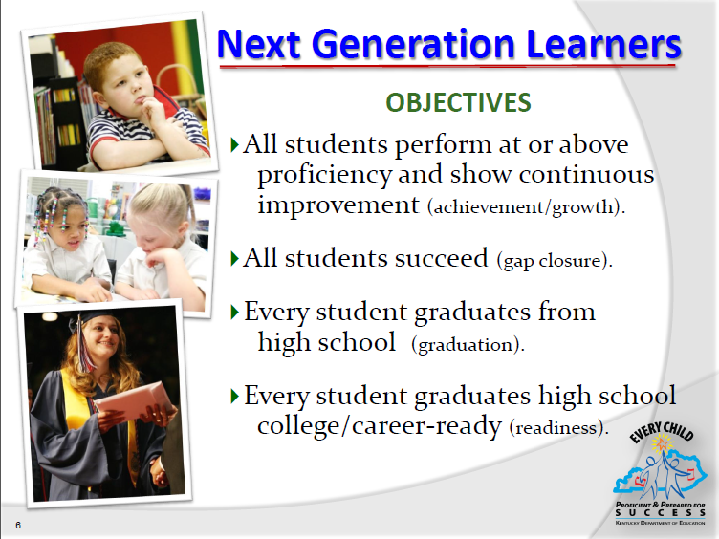
Notes:
Briefly share the objectives – read or paraphrase these.

Slide 13

Notes:
Briefly share the objectives – read or paraphrase these.

Slide 14

Notes:
Briefly share the objectives – read or paraphrase these.

Slide 15

Notes:
Briefly share the objectives – read or paraphrase these.
This is KDE’s VISION for today’s teachers.

Slide 16

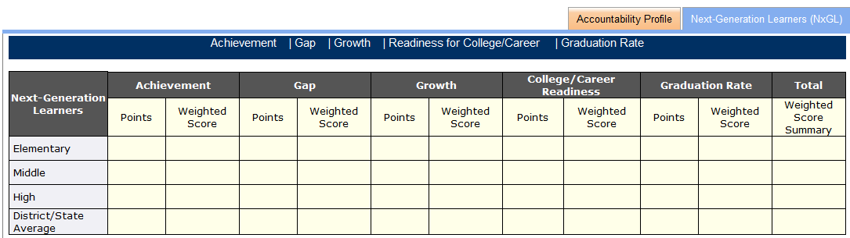
16
69.0 13.8 25 5 50.5 10.1 64 12.8 81 16.2 57.9
Weighted Score comes from Achievement, Gap, Growth, College/Career Readiness
and Graduation points multiplied by the
weights in the chart.
Weighted Score Summary comes from
adding the weighted scores for each area.
Grade Range | Achieve-ment | Gap | Growth | College/ Career | Grad Rate | Total
Shown as percentages
Elem | 30 | 30 | 40 |  |  | 100
Middle | 28 | 28 | 28 | 16 |  | 100
High | 20 | 20 | 20 | 20 | 20 | 100
Notes:
This is obviously where our focus is right now; the scores are important, but they are only one part of the story. How can you help develop teacher capacities, and how can the Teacher Professional Growth and Effectiveness System give you the tools to support them?

Slide 17
Covey’s Paradigm of Effectiveness
P/PC Balance
Resources
Results
Notes:
If we focus too much on the results and neglect the resources, gains will be short lived.
We need to develop a strategy for long term, sustainable gains.
Think back to your school

Slide 18
Covey’s Paradigm of Effectiveness
P/PC Balance
Results
Resources
Notes:
If we focus too much on the results and neglect the resources, gains will be short lived. (Click for “See Saw” animation)

Slide 19
Covey’s Paradigm of Effectiveness
P/PC Balance
Resources
Results
Notes:
We need to develop a strategy for long term, sustainable gains.
Think back to your school

Slide 20
Covey’s Paradigm of Effectiveness
P/PC Balance
Results
Resources
Notes:
Think back to your school

Slide 21

How can the Framework for Teaching be used to identify & support effective teaching practices
Notes:
How can we use the Framework for Teaching to identify and support effective teaching practices that provide the high level of results we want?
Let’s zone in on one component to see how.

Slide 22

Observation
Professional Growth
Student Voice
Peer Observation
Student Growth
Reflective Practice
Domain 1: Planning & Preparation
Domain 2: Classroom Environment
Domain 3: Instruction
Domain 4: Professional Responsibilities
Domain 5: Student Growth
Notes:
Reminder that the circles represent the multiple measures of the PGES. The data from these multiple measures is amalgamated and filtered through the domains of the Kentucky Framework For Teaching (an adaptation of the original research-based work of Charlotte Danielson). Those domains are: Planning & Preparation, Classroom Environment, Instruction, Professional Responsibilities, and Student Growth.
The Framework provides common language for teachers and principals to use when working toward effective teaching.
The measures provide supports for effective teaching.

Slide 23
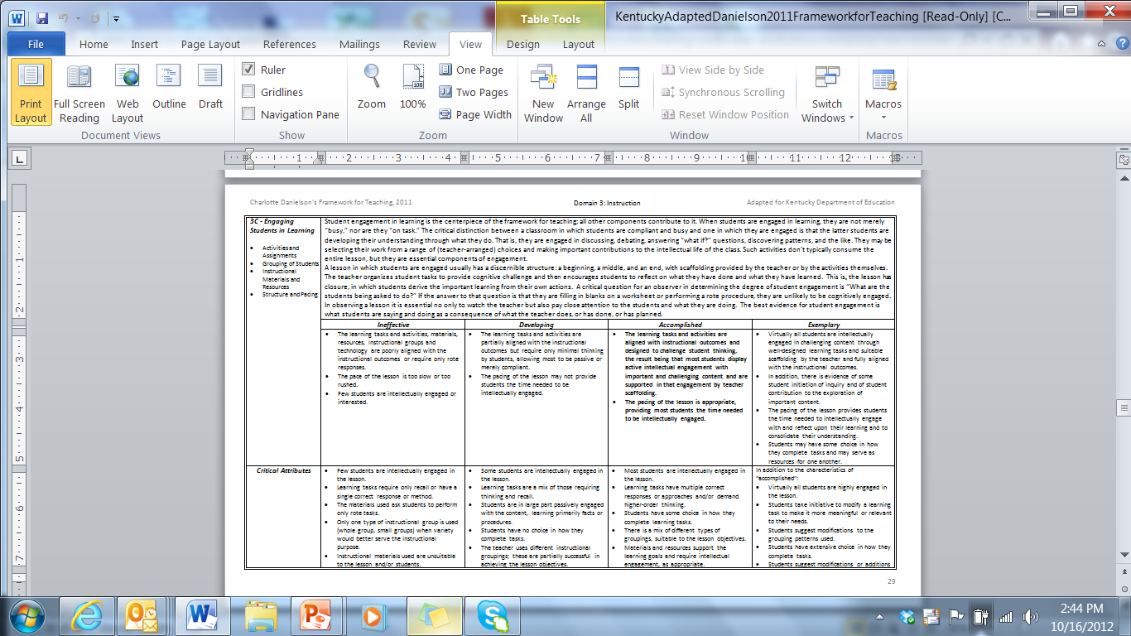
Zeroing in on 3C
Page 29
Notes:
Ask participants to refer to page 29 of the Framework in your materials (or a copy of that page provided in their ISLN packet). Student engagement in learning is the centerpiece for effective instruction. All other components contribute to it.
Component 3C - Engaging students in learning - is one way to identify effective practice.

Slide 24

Engaging Students in Learning
What is Accomplished?
1. Read the 3C component description and rubric.
2. Highlight the “look fors” for this component.
3. Discuss with your table group.
Notes:
Look at your Framework page for 29. Read directions on the slide.

Slide 25
Slide removed reduce file size

Slide 26
What is Engagement?
What stands out in 3C?
…they are not merely “busy,” nor are they “on task.”
…students are developing their understanding through what they do.
Notes:
What stands out in the component description for 3C? What would you hope to see in a classroom?
From the component description we see a description of the essence of engagement.
Engagement isn’t busy or on task; it is students developing their own understanding through what they do.
(Maybe make the connection here to CHETL – engagement)

Slide 27
Zeroing in on 3C
Page 29
Performance Level Indicators
Notes:
Refer to page 29 of the Framework again.
Look at the performance levels and indicators.
What did you highlight here the most critical language in each set of indicators. What are the “look fors”?

Slide 28
Accomplished | Exemplary
The learning tasks and activities are aligned with instructional outcomes and designed to challenge student thinking, the result being that most students display active intellectual engagement with important and challenging content and are supported in that engagement by teacher scaffolding. The pacing of the lesson is appropriate, providing most students the time needed to be intellectually engaged. | Virtually all students are intellectually engaged in challenging content through well-designed learning tasks and suitable scaffolding by the teacher and fully aligned with the instructional outcomes. In addition, there is evidence of some student initiation of inquiry and of student contribution to the exploration of important content. The pacing of the lesson provides students the time needed to intellectually engage with and reflect upon their learning and to consolidate their understanding. Students may have some choice in how they complete tasks and may serve as resources for one another.
Notes:
Notice what moves engagement to exemplary is the level of student ownership and student initiation. Teacher practice fosters this level of engagement that allows students to take responsibility for their own learning.

Slide 29
Instructional Tools with High Levels of Student Engagement
Rigorous implementation of the Common Core through:
Literacy Design Collaborative
Math Design Collaborative
Notes:
The LDC and MDC instructional tools teachers are using with their students facilitate rigorous implementation to the Common Core and contribute to high levels of student engagement. The changes in teacher practices embedded in these two instructional tools lead to high levels of student learning and have the potential to lead to changes in student achievement.
Make the point that this is going on in your building that can impact student achievement

Slide 30
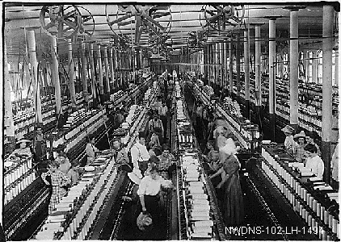
The British Industrial Revolution
LDC Module
Created through collaboration by
Sara Ballute, Candace Hurley, Timothy Lent

Slide 31
In the videoed lesson, instruction was built around the following question:
Were the achievements and growth of the Industrial Revolution Era worth the cost to society?
Students will write an argumentative essay.
Notes:
This question is posted in the classroom. You can tell that it is the underlying theme of what students are doing.

Slide 32

Let’s use analyze the instruction in this LDC clip using 3C as the look-for lens
Video Removed to reduce file size
Social Studies
Lesson
Notes:
As you watch this short clip from an LDC classroom, take notes about what you see and hear. When the clip ends, use 3C to note elements of engagement you noted. Share your comments with others at your table.
What did you notice?
What did you notice?

Slide 33
Let’s use analyze the instruction in this MDC clip using 3C as the look-for lens
Video Removed to reduce file size
Math Lesson
Notes:
As you watch this short clip from an MDC classroom, take notes about what you see and hear. When the clip ends, use 3C to note elements of engagement you noted.
What did you notice?
What did you notice?

Slide 34

PGES & Integration
Sites Share Out
What are you seeing?
Notes:
What’s the impact of the LDC and MDC on teacher effectiveness? What are you seeing in your school or classrooms as far as student engagement and other components of the Framework for Teaching?
Is the framework helping you see whether there is rigorous instruction aligned to the standards?

Slide 35
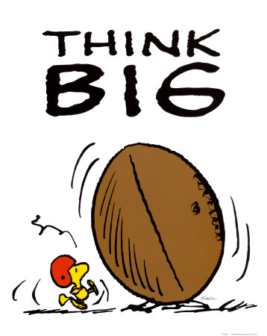
Now … let’s think beyond to other components within the Framework
GER
Notes:
Highlight – make note
What other components apply to what they will see in classrooms?

Slide 36
How will you share the framework so there is
a better understanding of effective teaching?
effective support for teachers?
Notes:
Provide graphic organize for planning. Give participants time to talk about this question. Ask for volunteers to share how they are already sharing this their principals and how teachers in their district are being supported in this vital work.
Common language and understanding of effective practices

Slide 37

Before Next Time
Visit a LDC and/or MDC classroom to enhance your list of look-fors and connections to the TPGES.
Check out the student growth module on KDE’s website
Field test participants – bring samples of student growth documents.
Notes:
Make sure they know where to find the module.

Slide 38
Make a visit
Visit a LDC and/or MDC classroom to enhance your list of look-fors and connections to the TPGES.
Notes:
Make sure they know where to find the module.
The more we can align initiatives and recognize how they influence each other, the smoother we can move forward in a consolidated direction.

Slide 39

Where To Learn More
Go to KDE Website.
Enter “Effective Teachers” into Search Box. Click on Effective Teachers OR
http://tinyurl.com/bmj47sz
http://tinyurl.com/ckxqdmg

Slide 40
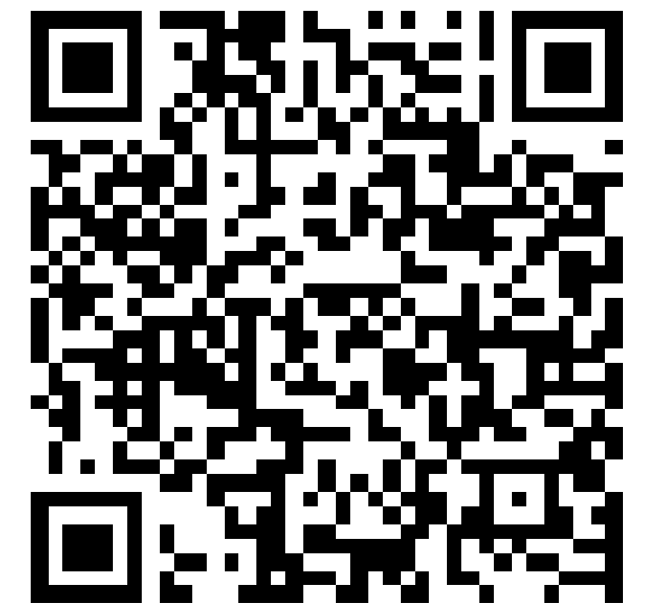
You can capture this QR code

Slide 41
Email resource -
If you have questions about the field test
Cathy.White@education.ky.gov
or
Mike.York@education.ky.gov

