Slide 1
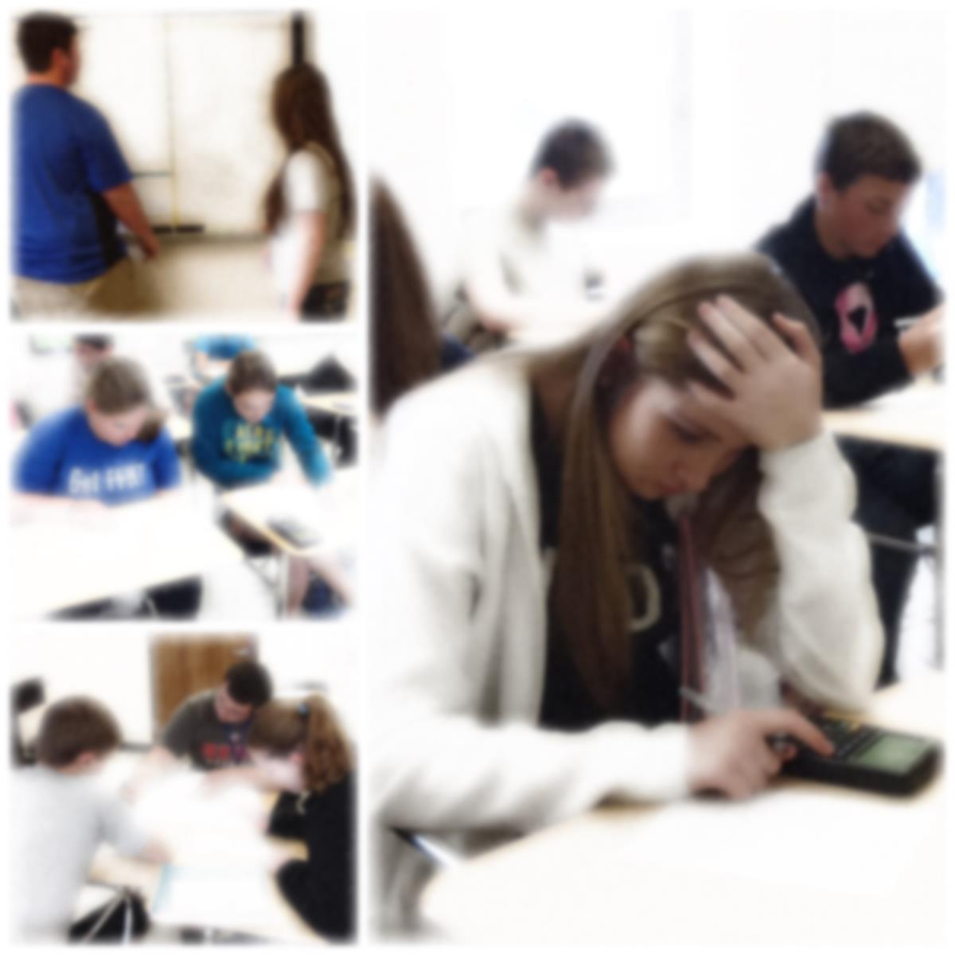
Math Design Collaborative
Middle Grades

Slide 2
Formative Assessment Lesson
Where are the Lessons?
http://map.mathshell.org

Slide 3
Pre Assessment
No Help!
Assessing Student Responses
Grouping Students
Creating Feedback Questions

Slide 4
Introduction
Whole Class Discussion
Not the time to teach

Slide 5
Temperature Changes
London
+13°C
Beijing
−5°C
Paris
+22°C
Vancouver
−11°C

Slide 6
Collaborative Work
Monitor Progress
Ask Questions
Take Notes

Slide 7
Instructions for Working Together
Take turns to place cards.
When it is your turn, connect two City Temperature cards using a Changes in Temperature arrow card.
Figure out any missing temperatures.
Explain your calculations.
If others in your group disagree, they should explain why. Then figure out the answer together.
When you have reached an agreement, write your solution in the box on the card.

Slide 8
Wrapping up!
Sharing Posters
Whole Class Discussion

Slide 9
More Temperature Changes
London
+8°C
+7°C
Madrid
_ _ _ _ _ _ _ _ _ _ _
Berlin
_ _ _ _ _ _ _ _ _ _ _
−12°C
Tromso
−7°C
Tromso
−7°C
_ _ _ _ _ _ _ _ _ _ _ _ _ _ _ _ _ _ _ _
London
+8°C

Slide 10
Post Assessment
No Help!
See the Growth

Slide 11
Placing your FALs
http://collegeready.gatesfoundation.org/Learning/MathDesignCollaborative
Leading Others

